Slide 1

Exploratory Data Analysis
G2M Case Study
Name: Zyad Al-Azazi
Location: Beirut, Lebanon
Team: Data and Analytics
Date: 14-March-2021

Slide 2

Agenda
Executive Summary
Problem Statement
Approach
EDA
EDA Summary
Recommendations

Slide 3
Executive Summary
This presentation aims to assist in the process of deciding on which company is the most valuable to invest in as part of the growing cab industry. The final recommendation is based on the nature of the market and the comparison between the companies in different, yet essential aspects.

Slide 4
Problem Statement
XYZ is a private firm in US. Due to remarkable growth in the Cab Industry in last few years and multiple key players in the market, it is planning for an investment in Cab industry.
Objective: Provide insights into the cab industry by recommending the better company for investment.
Format of the Analysis:
Approach
Exploratory Data Analysis (Understanding the Market & Comparison Between the Companies)
Exploratory Data Analysis Summary.
Recommendations.

Slide 5
Approach
- Understanding the data using descriptive data analysis.
Manipulating and cleaning the data.
The final data scheme consisted of 14 columns and 359392 rows.
The final data set was composed of the following datasets: “Cab_Data.csv”, “Customer.csv” and “Transaction.csv.” The “City.csv” dataset was not used as it did not provide sufficient insights that could help in making the decision.
Applying statistical analysis to understand the relationships between the different variables.
Visualizing data to further understand the distinction between the two companies and the relationships between the different variables.

Slide 6
Exploratory Data Analysis
In the following slides we will be exploring the visualizations and their interpretations.

Slide 7
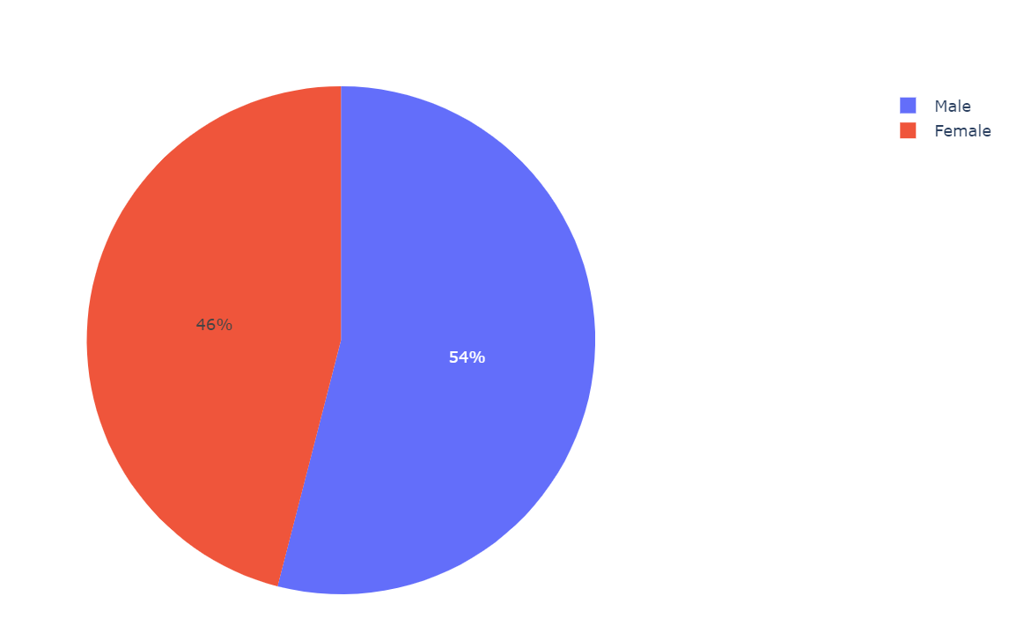
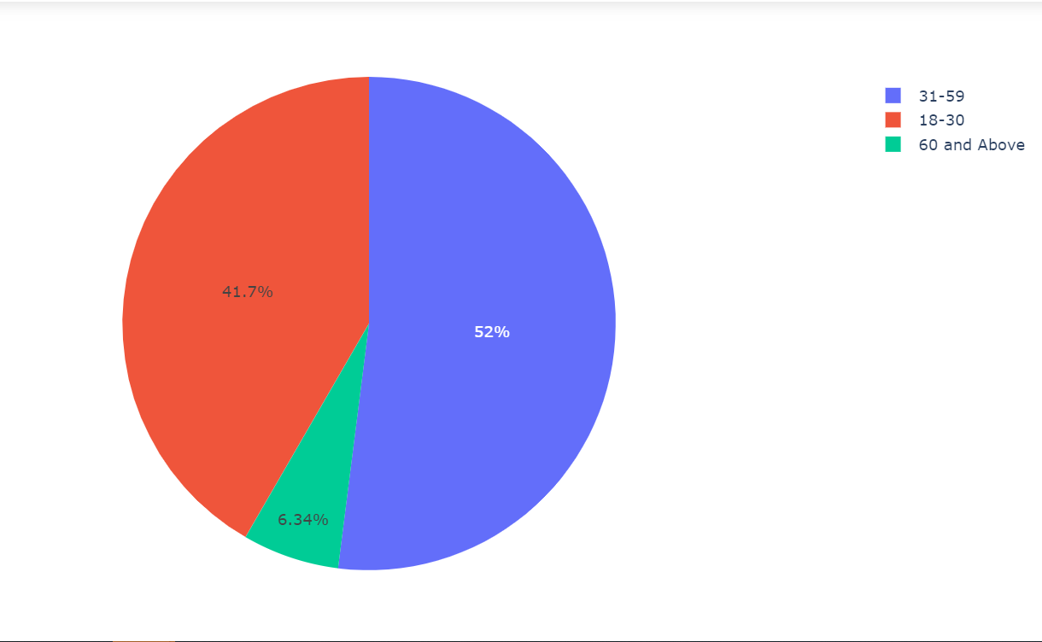
Understanding the Market (Customers)

Slide 8
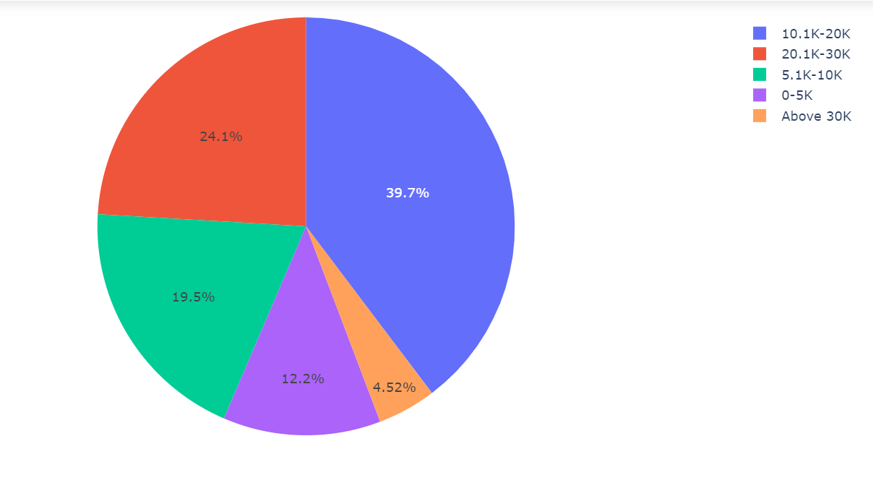
Understanding the Market (Customers)

Slide 9
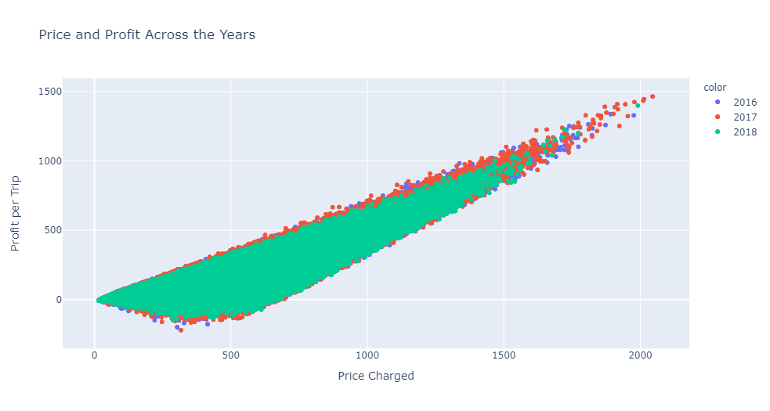
Understanding the Market (Price, Cost and Profit)
We can notice a constant trend in the relationship between the price and the profit of each trip. There is a small number of outliers that were date to 2017 – the year when the cab industry boomed.

Slide 10
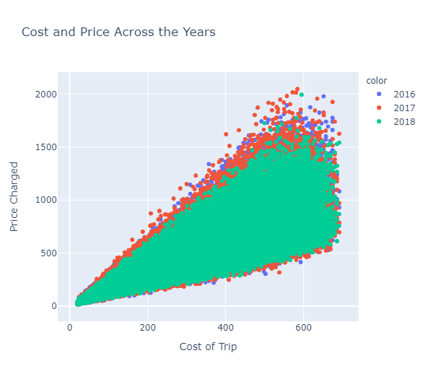
Understanding the Market (Price, Cost and Profit)
We can notice a constant trend in the relationship between the price and the cost of each trip. The small number of outliers of 2017 can also be noticed in this plot reflecting the high demand on the service.

Slide 11
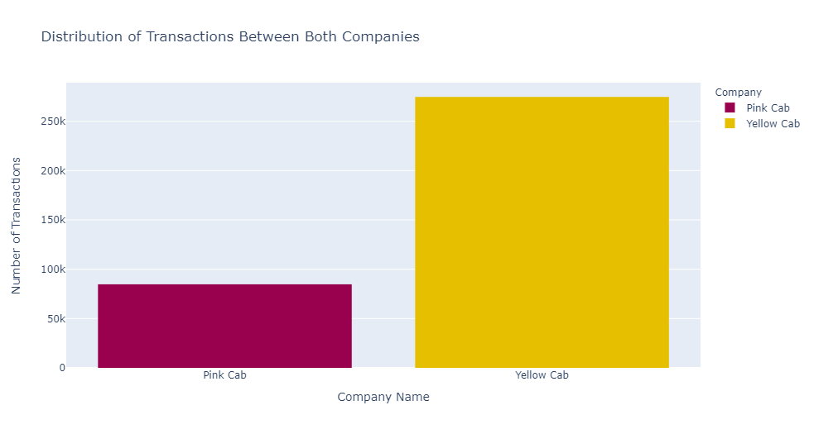
Comparison Between the Companies
This graph shows the significant difference in the number of trips in each company throughout the three years.

Slide 12
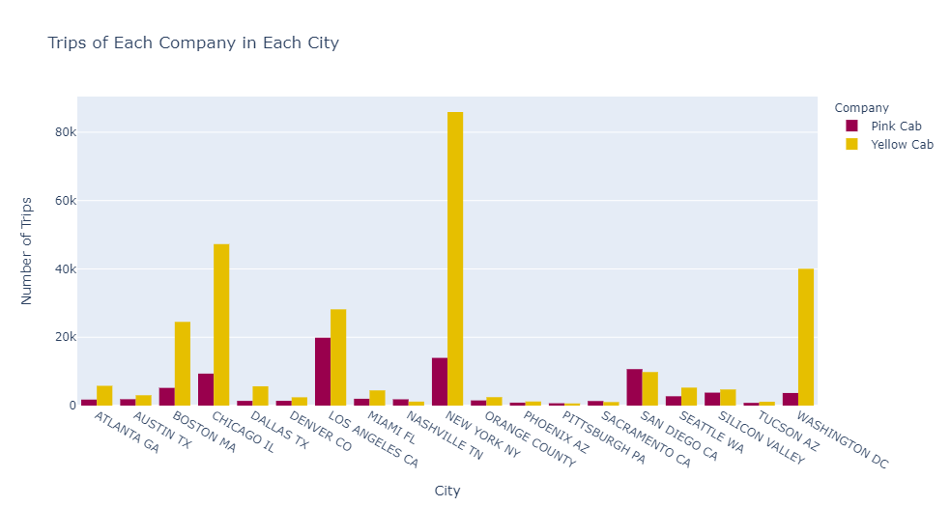
Comparison Between the Companies
This graph shows the aggregate number of trips in each city throughout the three years. We can see that the yellow company dominates in all cities except for 4 cities.

Slide 13
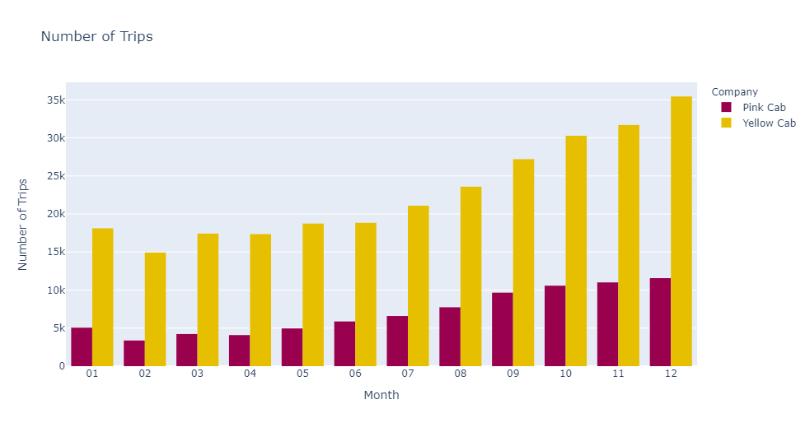
Comparison Between the Companies
This graph shows the aggregate number of trips in each month throughout the three years. It is very clear that the yellow cab company has been drastically performing better.

Slide 14
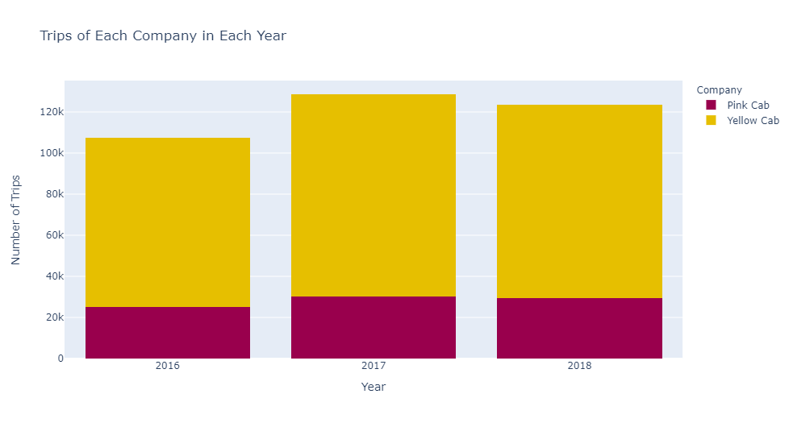
Comparison Between the Companies
This also shows the domination of the yellow cab company on the overall number of transactions in each year with over 50%.

Slide 15
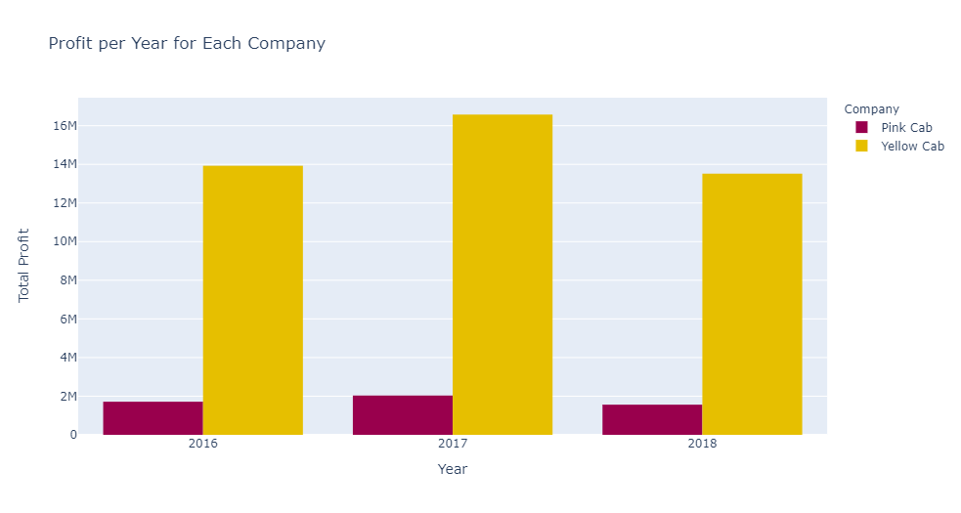
Comparison Between the Companies
This graph shows the annual profit of each company across the three years. Yellow cab company’s profit peak has reached 16 million USD in 2017, whereas pink cab’s profit was only 2 million USD in the same year.

Slide 16
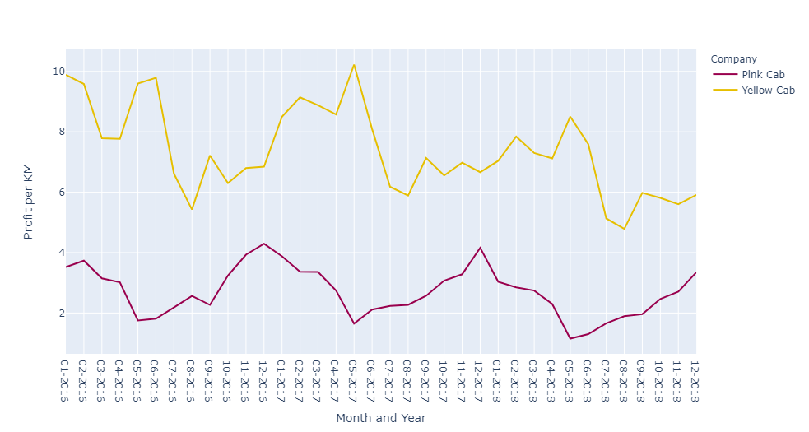
Comparison Between the Companies
In this graph, we explore the change of the average “profit per KM” throughout the period of the three years in every month. We can see that level of “profit per KM” for the yellow cab company is greater than pink cab’s in all months.

Slide 17
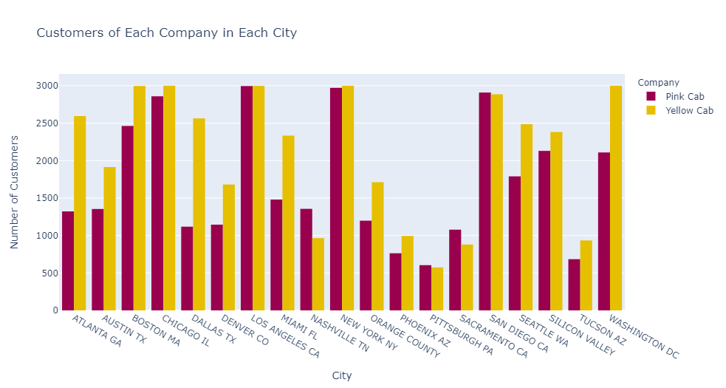
Comparison Between the Companies
This graph potentially showcases the reason for the yellow cab company’s profit and number of trips. The outreach of the yellow company, in terms of the number of customers is higher than the pink cab’s in 15 out of the 20 cities.

Slide 18
EDA Summary
Most of the customers have incomes that range between 10.1K USD and 30K USD.
The trend in cost in relation to profit and cost has been similar throughout the past years.
The Yellow cab company is superior to the Pink cab company, in terms of the number of trips, profit per KM and customer reach.

Slide 19
Recommendations
Based on the following:
Number of Trips (annual, monthly aggregate, in each city).
Annual Profit for Companies.
Monthly Average “Profit per KM.”
Companies’ Customer Base in Each City.
The final recommendation is to invest in the Yellow Cab company.

Slide 20
Thank You

